Slide 1
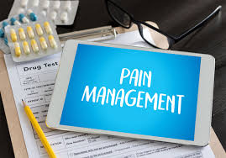
Adult Nursing(1) 2nd Stage
Pain management (Practice)
Lecture 2
By
Assistant. Lecturer. Zainab Salman Dawood
Fundamentals of Nursing Department
College of Nursing
University of Basrah
University of Basrah –College of Nursing – Fundamentals of Nursing Department

Slide 2
Definition of Pain
The American Pain Society (APS) defines pain as “an unpleasant sensory and emotional experience associated with actual or potential tissue damage. This definition describes pain as a complex phenomenon that can impact a person’s psychosocial, emotional, and physical functioning.
The clinical definition of pain reinforces that pain is a highly personal and subjective experience: “Pain is whatever the experiencing person says it is, existing whenever he says it does” .
University of Basrah –College of Nursing– Fundamentals of Nursing Department

Slide 3
Effects of Pain
Pain affects individuals of every age, sex, race, and socioeconomic class. It is the primary reason in which people seek health care and one of the most common conditions that nurses treat. Unrelieved pain has the potential to affect every system in the body and cause numerous harmful effects, some of which may last a person’s lifetime.
University of Basrah-College of Nursing– Fundamentals of Nursing Department

Slide 4
Types and Categories of Pain
1)Pain can be categorized as being acute or chronic (persistent) based on duration .
Chronic pain is subcategorized as being of cancer or non-cancer origin
Some conditions can produce both acute and chronic pain. For example, some patients with cancer have continuous chronic pain and also experience acute exacerbations of pain periodically —called breakthrough pain (BTP).
University of Basrah-College of Nursing– Fundamentals of Nursing Department

Slide 5
Acute pain | Chronic pain
Serves a useful warning function | No longer serves as a useful warning function.
It is a symptom of underlying disease or injury | May be symptomatic of an underlying chronic disease or may exist in the absence of underlying disease
Acute pain stops after the injury heals or the disease runs its course | Continues long after the initial injury has healed or the disease is over.
Example, tissue damage as a result of surgery, trauma, or burns produces acute pain | Examples of chronic pain include peripheral neuropathy from diabetes, and osteoarthritis pain from joint degeneration.
Expected to have a relatively short duration and resolve with normal healing. | Pain that persists longer than 6 months (sometimes longer than 3 months)
University of Basrah-College of Nursing– Fundamentals of Nursing Department

Slide 6
2) Pain is better classified by its inferred pathology as being either nociceptive pain or neuropathic pain
Nociceptive (physiologic) pain refers to the normal functioning of physiologic systems that leads to the perception of noxious stimuli (tissue injury) as being painful. This is why nociception is described as “normal” pain transmission.
Neuropathic (pathophysiologic) pain is pathologic and results from abnormal processing of sensory input by the nervous system as a result of damage to the peripheral or central nervous system (CNS) or both.
Patients may have a combination of nociceptive and neuropathic pain. For example, a patient may have nociceptive pain as a result of tumor growth and also report radiating sharp and shooting neuropathic pain if the tumor is pressing against a nerve plexus.
University of Basrah-College of Nursing– Fundamentals of Nursing Department

Slide 7
Pain Assessment
It serves as the foundation for developing and evaluating the effectiveness of the pain treatment plan. Comprehensive Pain Assessment Performed in the following situation:
Conducted during the initial interview with the patient.
Conducted with each new report of pain.
Conducted when indicated by changes in the patient’s condition or treatment plan during the course of care.
University of Basrah-College of Nursing– Fundamentals of Nursing Department

Slide 8
The following are components of a comprehensive pain assessment and tips on how to elicit the information from the patient:
University of Basrah-College of Nursing– Fundamentals of Nursing Department

Slide 9
1- Location(s) of pain:
Ask the patient to state or point to the area(s) of pain on the body. Sometimes allowing patients to make marks on a body diagram is helpful in gaining this information.
University of Basrah-College of Nursing– Fundamentals of Nursing Department

Slide 10
2- Onset and duration:
Ask the patient when the pain started and whether it started gradually or suddenly.
University of Basrah-College of Nursing– Fundamentals of Nursing Department

Slide 11
3- Intensity:
Ask the patient to rate the severity of the pain using a reliable and valid pain assessment tool.
University of Basrah-College of Nursing– Fundamentals of Nursing Department

Slide 12
4- Quality:
Ask the patient to describe how the pain feels. Descriptors such as “sharp,” “shooting,” or “burning”.
University of Basrah-College of Nursing– Fundamentals of Nursing Department

Slide 13
5- Aggravating and relieving factors
Ask the patient what makes the pain worse and what makes it better.
University of Basrah-College of Nursing– Fundamentals of Nursing Department

Slide 14
6- Radiation
Ask the patient whether pain is constant or radiated.
If radiated, ask him to determine sites that pain radiated to it.
University of Basrah-College of Nursing– Fundamentals of Nursing Department

Slide 15
7- Effect of pain on function and quality of life
The effect of pain on the ability to perform recovery activities should be regularly evaluated in the patient with acute pain. It is particularly important to ask patients with persistent pain about how pain has affected their lives, what could they do before the pain began that they can no longer do, or what they would like to do but cannot do because of the pain.
University of Basrah-College of Nursing– Fundamentals of Nursing Department

Slide 16
8- Other information:
The patient’s culture, past pain experiences, and pertinent medical history such as comorbidities, laboratory tests, and diagnostic studies are considered when establishing a treatment plan.
University of Basrah-College of Nursing– Fundamentals of Nursing Department

Slide 17
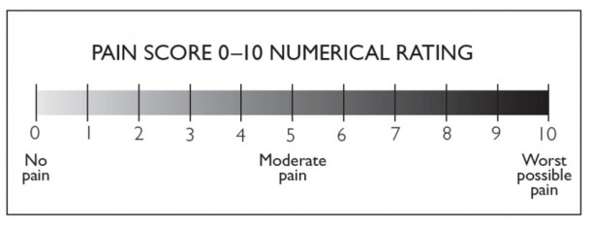
Pain assessment tools
1) Numeric Rating Scale (NRS): The NRS is most often presented as a horizontal 0- to-10-point scale, with word anchors of “no pain” at one end of the scale, “moderate pain” in the middle of the scale, and “worst possible pain” at the end of the scale.
University of Basrah-College of Nursing– Fundamentals of Nursing Department

Slide 18
2) Wong-Baker FACES Pain Rating Scale: The FACES scale consists of six cartoon faces with word descriptors, ranging from a smiling face on the left for “no pain (or hurt)” to a frowning, tearful face on the right for “worst pain (or hurt).” Patients are asked to choose the face that best reflects their pain. The FACES scale is used in adults and children as young as 3 years.
University of Basrah-College of Nursing– Fundamentals of Nursing Department

Slide 19
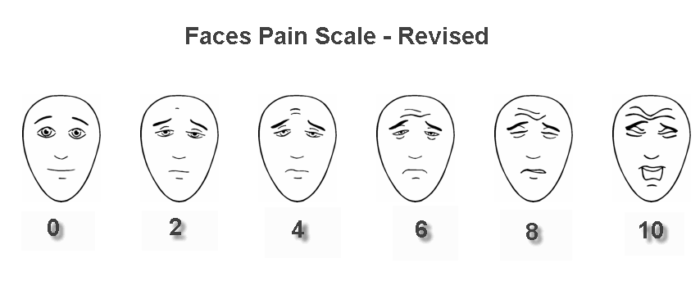
3) Faces Pain Scale–Revised (FPS-R): The FPS-R has six faces to make it consistent with other scales using the 0 to 10 metric. Patients are asked to choose the face that best reflects their pain. Faces scales have been shown to be reliable and valid measures in children as young as 3 years of age
University of Basrah-College of Nursing– Fundamentals of Nursing Department

Slide 20
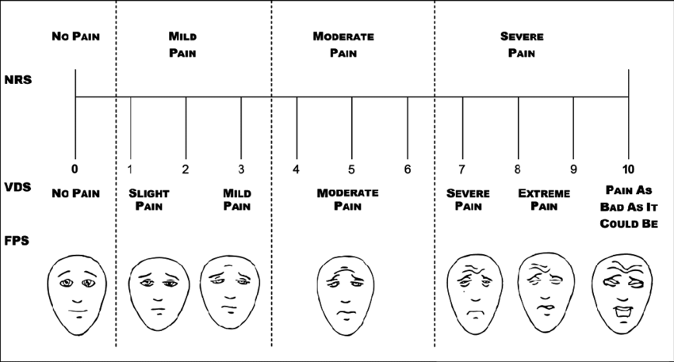
4) Verbal descriptor scale (VDS): uses different words or phrases to describe the intensity of pain, such as “no pain, mild pain, moderate pain, severe pain, very severe pain, and worst possible pain.” The patient is asked to select the phrase that best describes pain intensity.
University of Basrah-College of Nursing– Fundamentals of Nursing Department

Slide 21
5) Visual Analog Scale (VAS): The VAS is a horizontal (sometimes vertical) 10-cm line with word anchors at the extremes, such as “no pain” on one end and “pain as bad as it could be” or “worst possible pain” on the other end. Patients are asked to make a mark on the line to indicate intensity of pain, and the length of the mark from “no pain” is measured and recorded in centimeters or millimeters. Although often used in research, the VAS is impractical for use in daily clinical practice and rarely used in that setting.
University of Basrah-College of Nursing– Fundamentals of Nursing Department

Slide 22
Nursing diagnosis
Pain related to injuring agents (biological, chemical, physical, psychological) manifested by patient’s report of pain.
Planning
Reports ability to get enough comfort, sleep, and rest.
Nursing Interventions
Observe for nonverbal indicators of pain: moaning, guarding, crying, facial grimace.
Accept the patient’s description of pain.
Obtain vital signs.
Make sure of the client’s current use of medications.
Anticipate the need for pain management.
University of Basrah-College of Nursing– Fundamentals of Nursing Department

Slide 23
6- Provide a quiet environment.
7- Use non-pharmacological pain relief methods (relaxation exercises, breathing exercises, music therapy).
8- Provide optimal pain relief by administering prescribed pain relief medication.
9- Review patient’s medication records and flow sheet.
Evaluation
Evaluate patient's response to pain management
University of Basrah-College of Nursing– Fundamentals of Nursing Department

Slide 24
Thanks
University of Basrah-College of Nursing– Fundamentals of Nursing Department

